Slide 1
IAQ Market Success and Support
eMail: ra@kggconsulting.com | 844.750.4197
Why Indoor Air Matters
IAQ MATTERS
SUCCESS FORMULA
KGG RESOURCES
TREATMENT
CLEAN COMFORT LINEUP
EXTRAS
3
Our Homes: “a container of harm”
- BILL HAYWARD, CEO. Haywardscore.com
Meals a day
8
Contaminant Sources:
People, pets, cooking, cleaning & personal care
VOCs, Mold, crawl spaces
More insulated and tighter than ever before and we spend over 90% of our lives inside!
HOMES IMPACT OUR HEALTH!
Glasses of water a day
Breaths a day
23,000

Slide 2
IAQ Market Success and Support
eMail: ra@kggconsulting.com | 844.750.4197
Why Indoor Air Matters
IAQ MATTERS
SUCCESS FORMULA
KGG RESOURCES
TREATMENT
CLEAN COMFORT LINEUP
EXTRAS
Adapt to the current environment
Challenge your customers to rethink their Company’s Personality in this Public Health Era
You are on the right side
Sell the New Normal with confidence and integrity
Why Does IAQ Matter?
Differentiation
Profit margin
Money is being spent on healthy lifestyles
There’s multiple solutions - get your dealers to offer IAQ accessories and bundles
People are being helped!!!

Slide 3
IAQ Market Success and Support
eMail: ra@kggconsulting.com | 844.750.4197
Formula for Distributor Success
IAQ MATTERS
SUCCESS FORMULA
KGG RESOURCES
TREATMENT
CLEAN COMFORT LINEUP
EXTRAS
Promote IAQ
Train on IAQ
Talk about IAQ Preach issues and solutions’ effectiveness. Preach easy installations.
Use our Local Reps
Secret Sauce Ride-alongs with Reps. (or zoom-alongs)
Have inventory in-stock
Encourage Contractors to have inventory on their trucks
Encourage Contractors to use the Video in the selling process!

Slide 4
IAQ Market Success and Support
eMail: ra@kggconsulting.com | 844.750.4197
The KGG Team is here to help!
IAQ MATTERS
SUCCESS FORMULA
KGG RESOURCES
TREATMENT
CLEAN COMFORT LINEUP
EXTRAS
Premier IAQ Products Multiple brands that are vetted and proven technology
Nationwide Coverage Providing you with the most comprehensive support
Local Reps Fully trained IAQ experts
Nate Training Available IAQ Basic Training is 1-hour CEU
Online Training IAQ Courses and certification available
Unique Sales & Marketing Tools Including the proven IAQ video brochure
REPTalk HVAC industry focused podcast
IAQA Members All of our rep agencies are members of this leading
Industry association

Slide 5
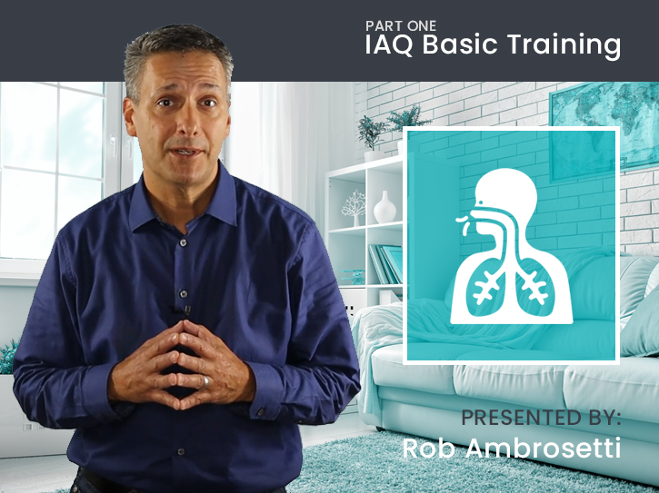
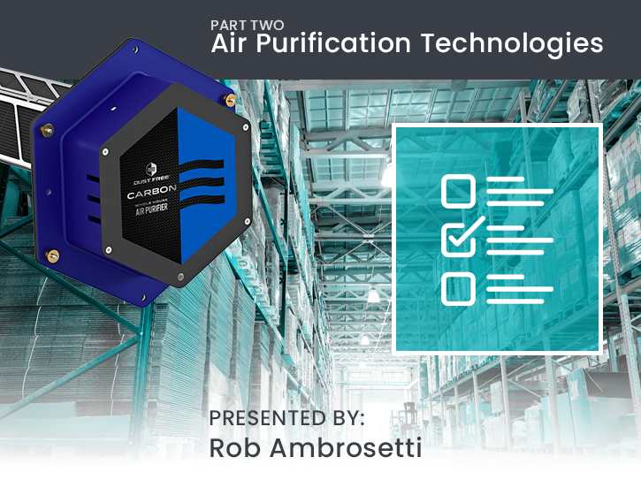
IAQ Market Success and Support
eMail: ra@kggconsulting.com | 844.750.4197
The KGG Team is here to help!
IAQ MATTERS
SUCCESS FORMULA
KGG RESOURCES
TREATMENT
CLEAN COMFORT LINEUP
EXTRAS
Online IAQ Training
kggconsulting.com/hvac-training/online or text IAQ to 31996
PART 1
IAQ Basic Training
PART 2
Air Purification Technologies
PART 3
Selling Clean Air

Slide 6
IAQ Market Success and Support
eMail: ra@kggconsulting.com | 844.750.4197
Familiarize yourself with Treatment Strategies
IAQ MATTERS
SUCCESS FORMULA
KGG RESOURCES
TREATMENT
CLEAN COMFORT LINEUP
EXTRAS
Humidity Control It’s not just for comfort! Pathogens thrive in both dry and wet conditions. Use Humidifiers & Dehumidifiers to maintain 40-60% relative humidity.
Air Filtration Filters can help remove particulate matter in the air. There is room for improvement if your system is using a 1” disposable type filter. Most hardware stores sell filters that are NOT capable of improving filtration. Install a media air cleaner with a MERV rating of 11 or 13. For “hospital grade air filters” which are MERV 17 or higher, install a HEPA rated air filtration system.
Air dilution (ventilation with outside air)
Studies show that fresh air helps hamper the spread of microbes and keeps indoor air from getting polluted.
If you can’t open your windows due to outdoor conditions, bring the fresh air in mechanically with Heat Recovery Ventilators (HRVs) or Energy Recovery Ventilators (ERVs)
Air Purification Install a device that proactively treats all three contaminants; Germs, Odors & Particulates. Look for one that will treat the air AND surfaces in a space.

Slide 7
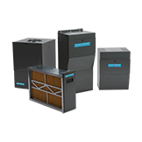
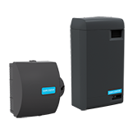
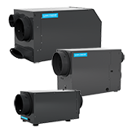
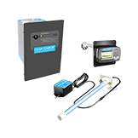
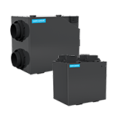
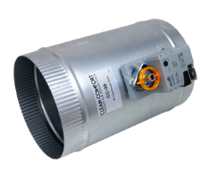
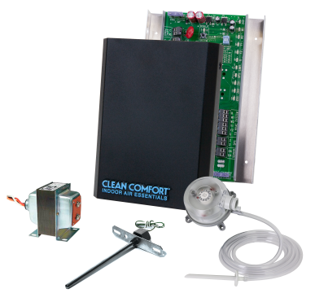
IAQ Market Success and Support
eMail: ra@kggconsulting.com | 844.750.4197
Clean Comfort Lineup
IAQ MATTERS
SUCCESS FORMULA
KGG RESOURCES
TREATMENT
CLEAN COMFORT LINEUP
EXTRAS
Filtration
Humidification
Dehumidification
Purification
Ventilation
Zoning

Slide 8
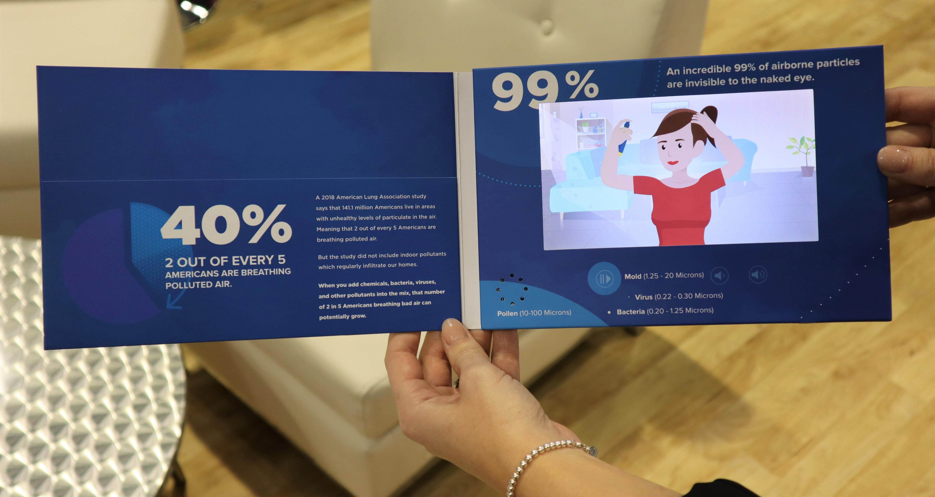
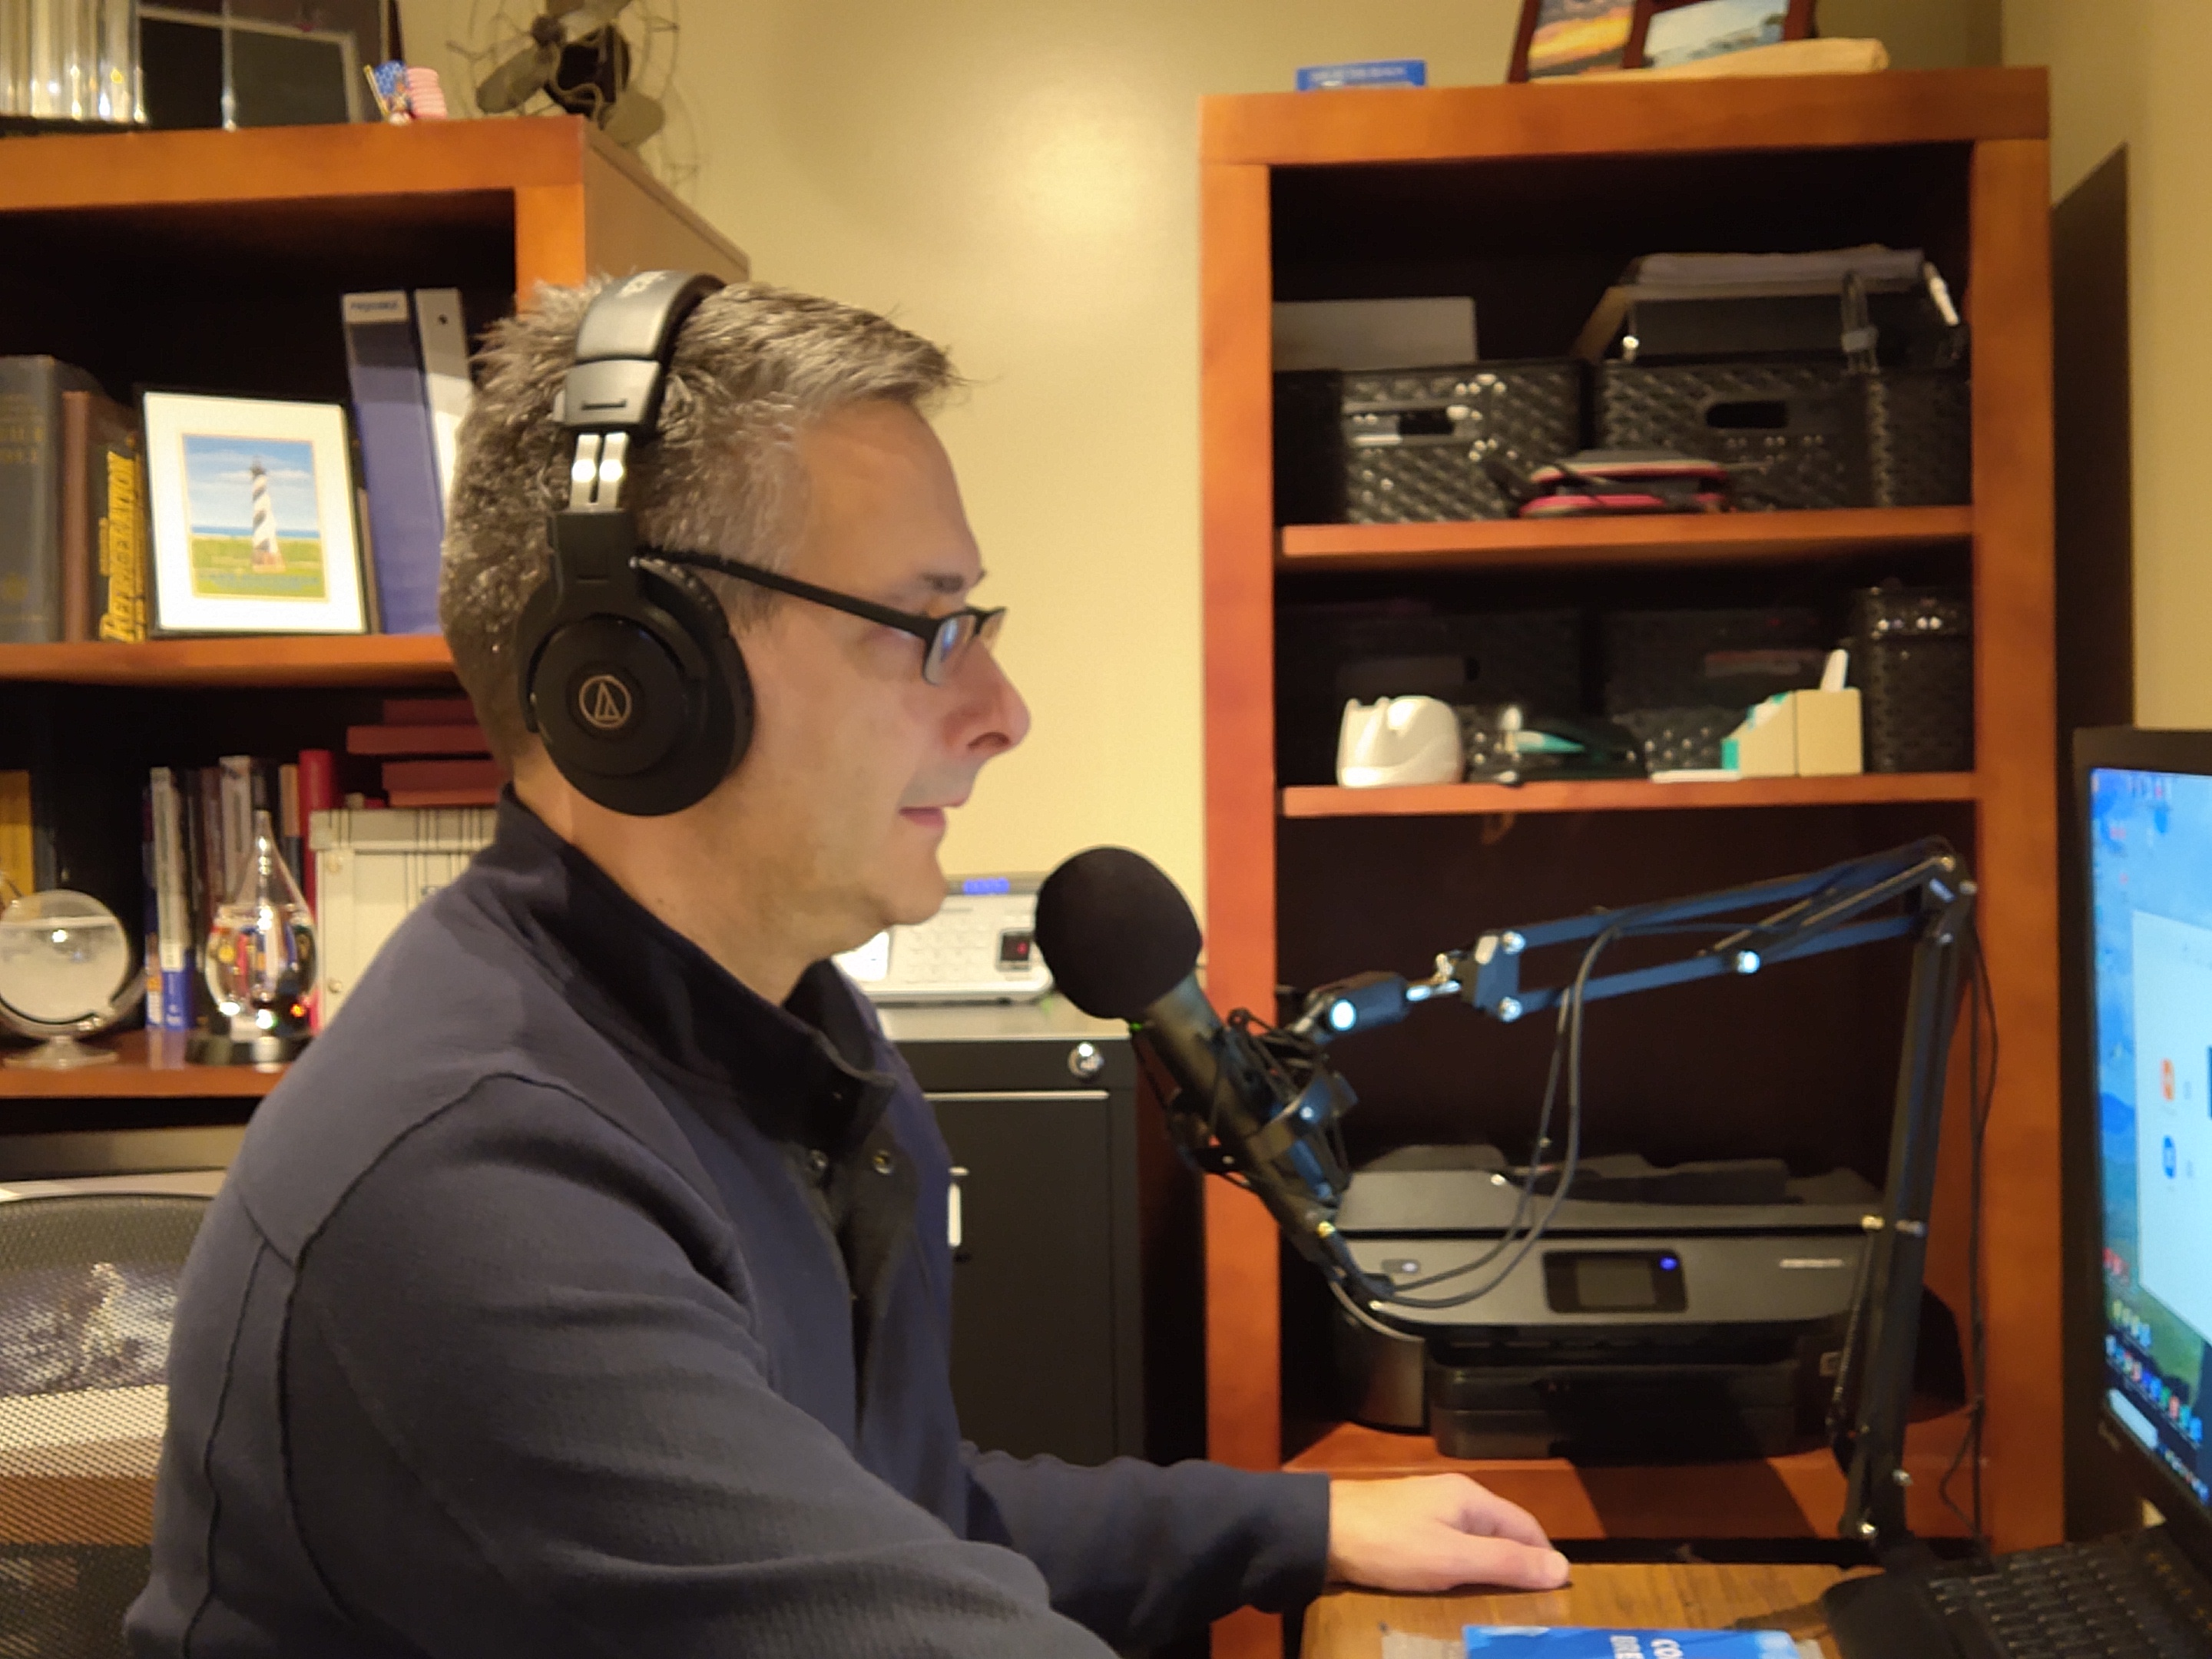
IAQ Market Success and Support
eMail: ra@kggconsulting.com | 844.750.4197
Additional Resources Available to You
IAQ MATTERS
SUCCESS FORMULA
KGG RESOURCES
TREATMENT
CLEAN COMFORT LINEUP
EXTRAS
USE THE VIDEOS TO HELP EXPLAIN IAQ
CONSUMER AWARENESS & IAQ SUPPORT RESOURCE

